Slide 1






------Celesta------
VERDANT ODEYSSEY
WEB DEVELOPMENT-TASK 2
PRESENTED TO
INDIAN INSTITUTE OF PATNA

Slide 2



THE TEAM
Tharun kiruthik K S
Subaleka K R
Kanitha Chellam V
Dept of computer science engineering
Dept of Information technology
Dept of AI & DS
Kiruthika C K
Dept of AI & DS
01

Slide 3



CONTENTS
1
Possible solutions
3
Wireframes & Prototyping
2
Target audience
4
Empathy map
02

Slide 4






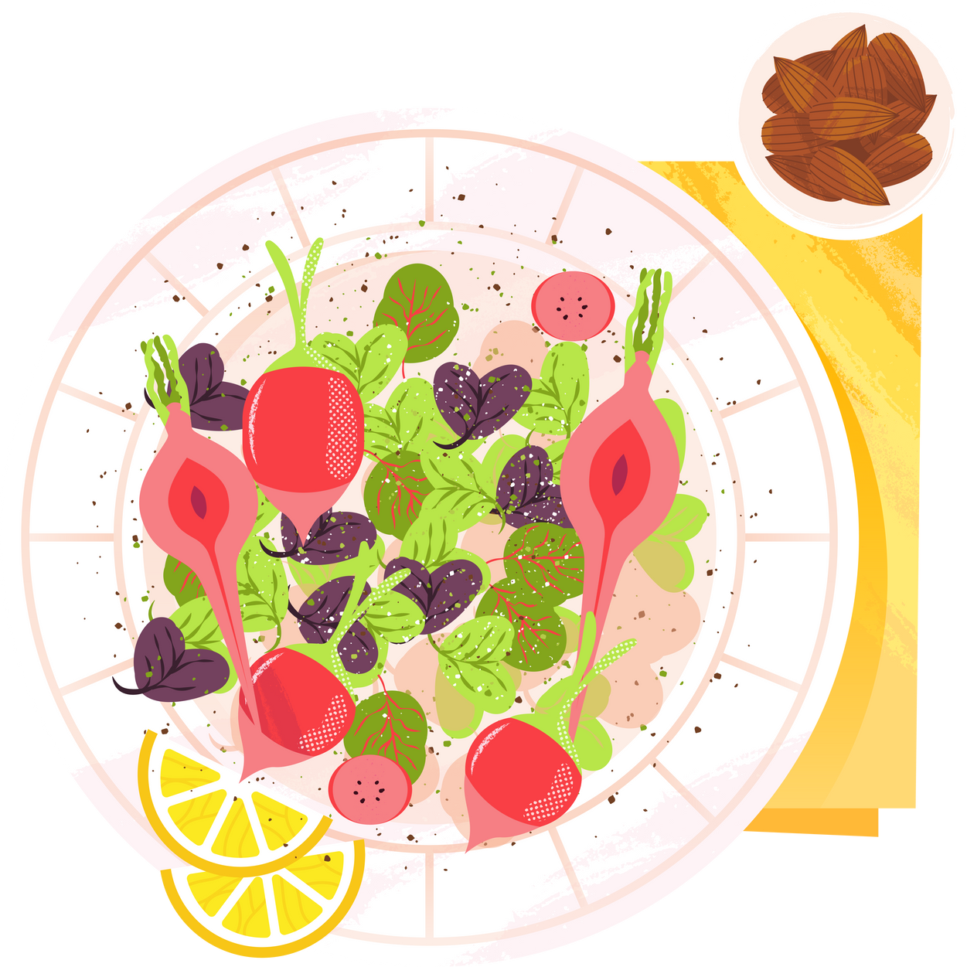
POSSIBLE SOLUTION
MEDICATION SUPERVISION
24/7 CHAT BOT
EMERGENCY CONTACTS
HEALTH DASHBOARD
COMMUNICATION HUB
DIET CHOICES
03

Slide 5


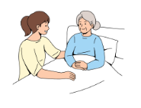
TARGET AUDIENCE
SENIOR CITIZEN
CAREGIVERS AND FAMILY
Members
04

Slide 6
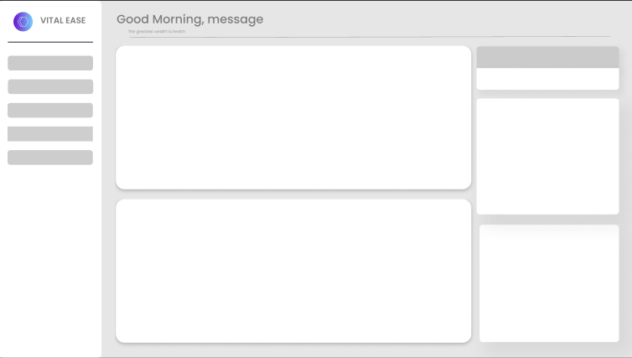
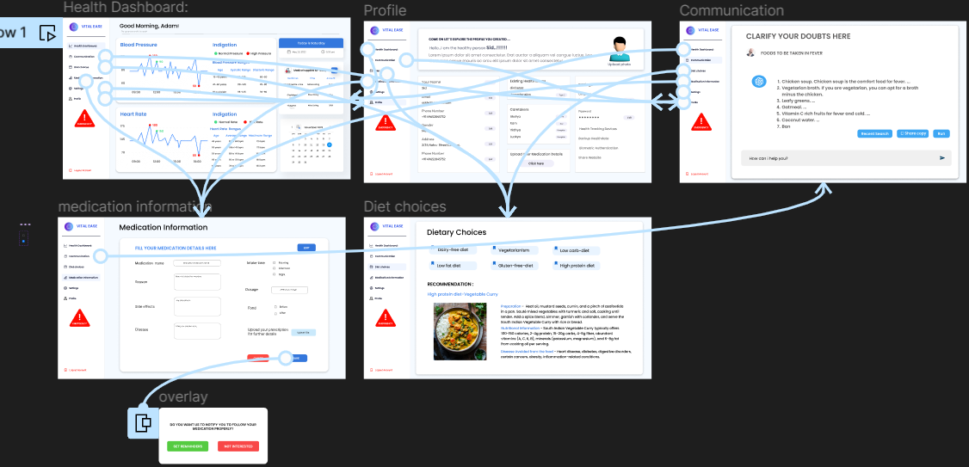
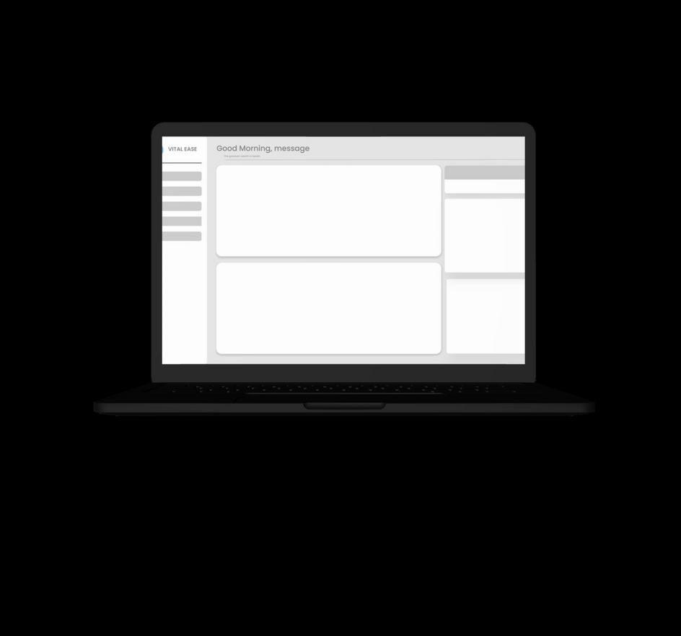
Wirframes
Prototype
05

Slide 7

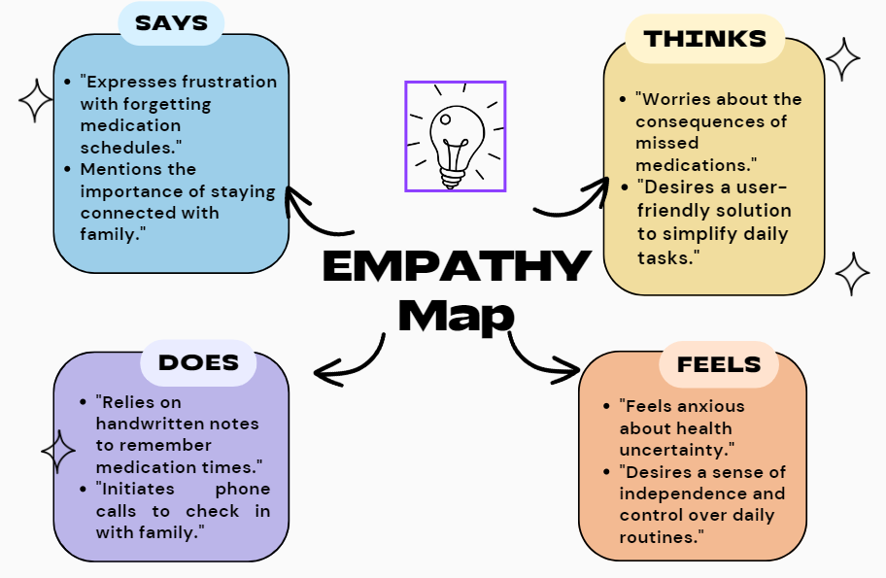

06

Slide 8

THANK
YOU

